Slide 1
GraphGAN:Graph Representation Learning with Generative Adversarial Nets

Slide 2
Generative Adversarial Net
Two-player game
Generator
Noise → Real data distribution
Discriminator
Positive sample (real data)
Negative sample (generation)

Slide 3
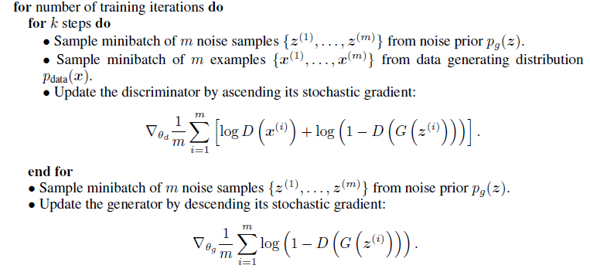
Framework of GAN

Slide 4
Abstract & Introduction
Graph representation learning (what)
Graph → low-dimensional vector
Purpose (do what)
Link prediction
Node classification
Recommendation

Slide 5
Abstract & Introduction
Methods (how)
Generative models
Discriminative models
Motivation
GAN
Graph softmax
Normalization
Graph structure awareness
Computational efficiency

Slide 6
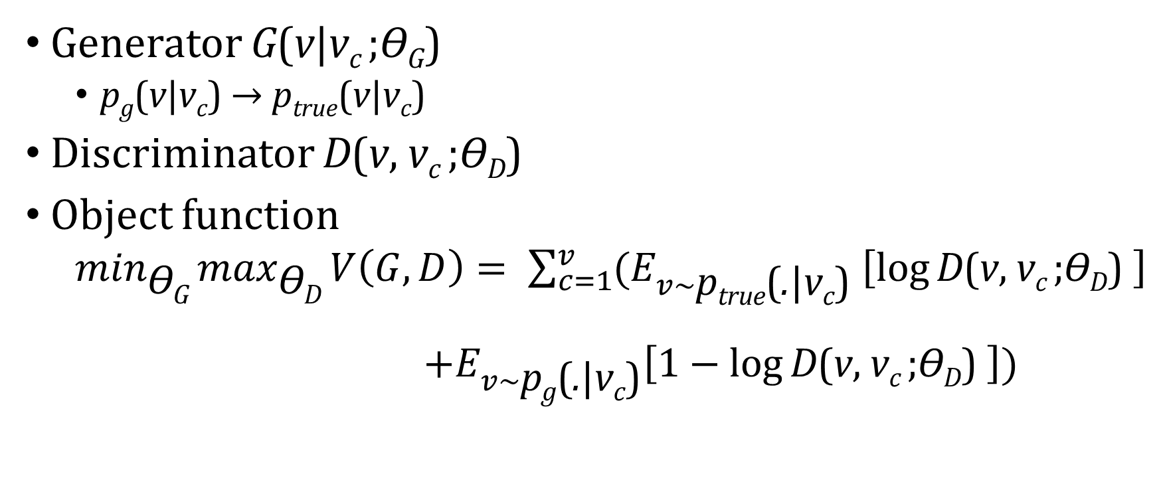
Graph Generative Adversarial Nets
Generator G(v|v_{c} ;ϴ_{G})
p_{g}(v|v_{c}) → p_{true}(v|v_{c})
Discriminator D(v, v_{c} ;ϴ_{D})
Object function
$\min_{\text{ϴ}\text{G}}{\max_{\text{ϴ}\text{D}}{V\left(G, D\right)= \sum_{c=1}^{v}{(E_{v\sim \text{p}\text{true}\text{(}\text{.}\text{|}\text{v}\text{c}\text{) }}\left[\log{\text{D}\text{(}\text{v}\text{, }\text{v}\text{c} \text{;}\text{ϴ}\text{D}\text{) }}\right]}}}$
$+E_{v\sim \text{p}\text{g}\text{(}\text{.}\text{|}\text{v}\text{c}\text{)}}\left[1−\log{\text{D}\text{(}\text{v}\text{, }\text{v}\text{c} \text{;}\text{ϴ}\text{D}\text{) }}\right])$

Slide 7
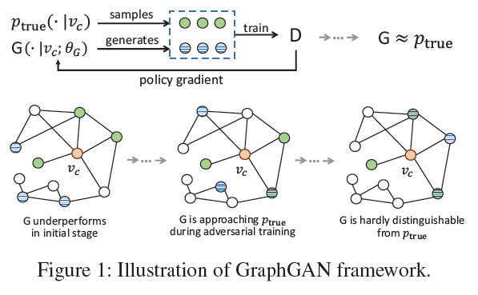

Slide 8

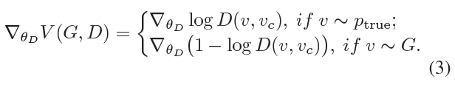
Discriminator Optimization

Slide 9
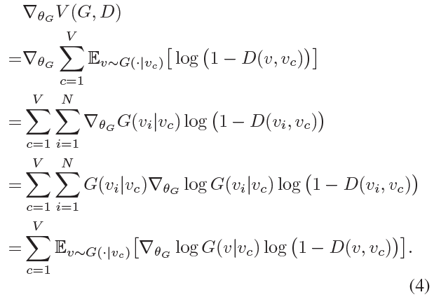

Generator Optimization

Slide 10
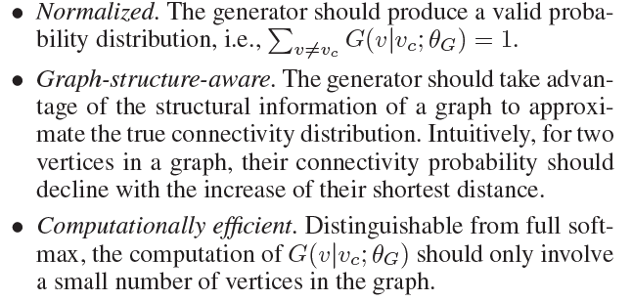
Graph softmax for Generator

Slide 11
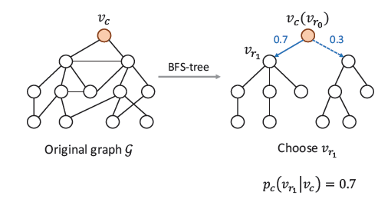

BFS tree

Slide 12

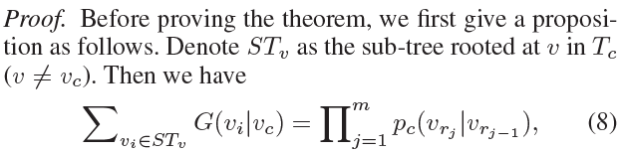

Slide 13
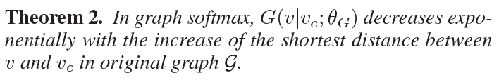
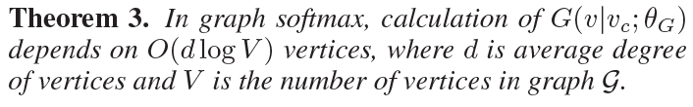

Slide 14
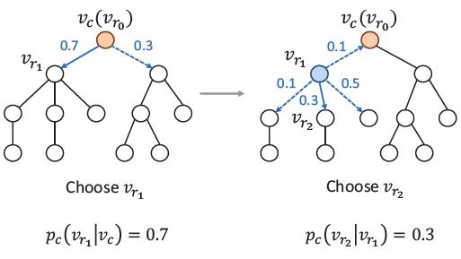
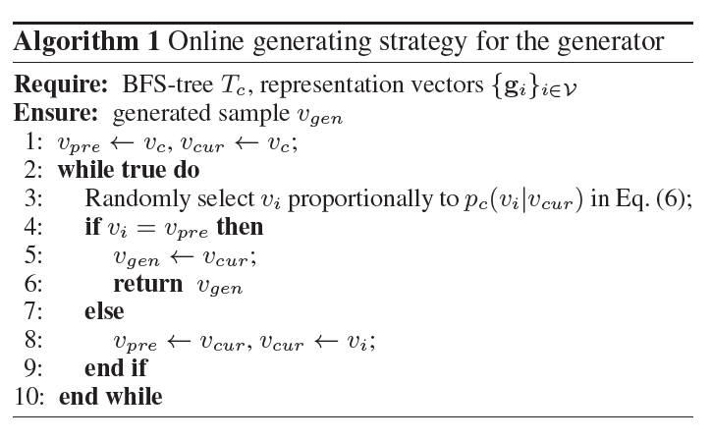
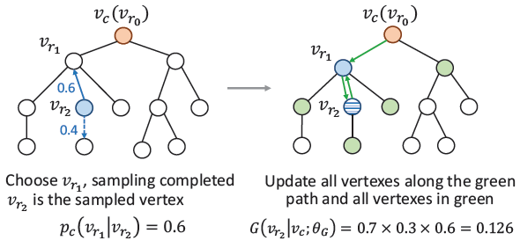

Slide 15
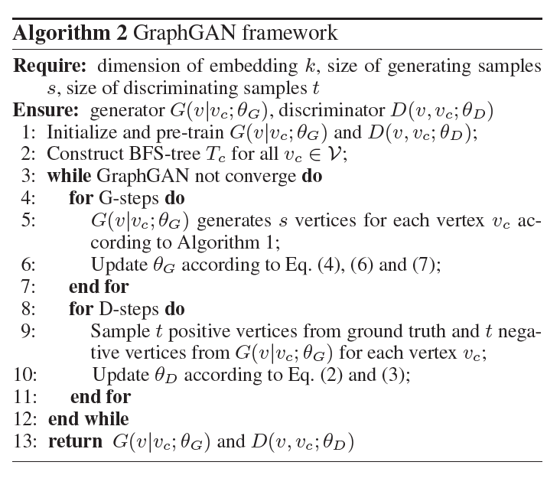

Slide 16
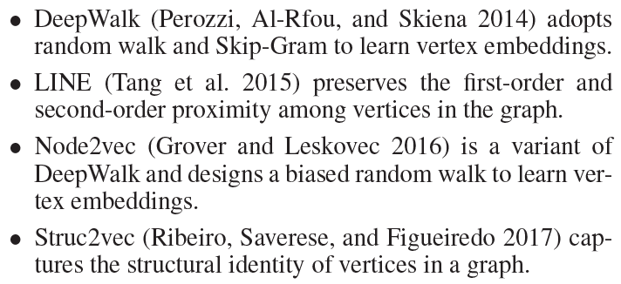
Experiments

Slide 17
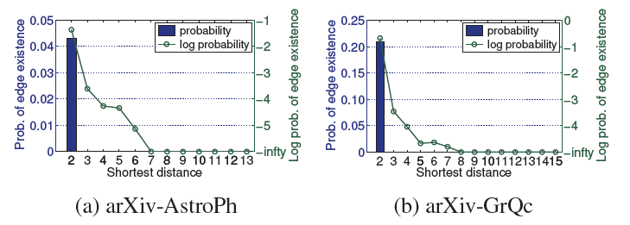

Slide 18
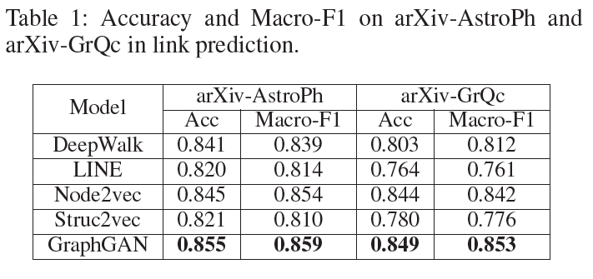
Link prediction

Slide 19
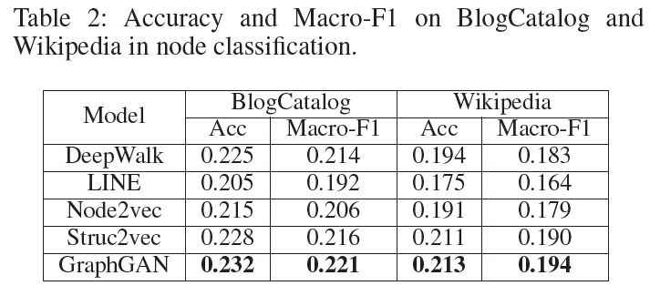
Node classfication

Slide 20
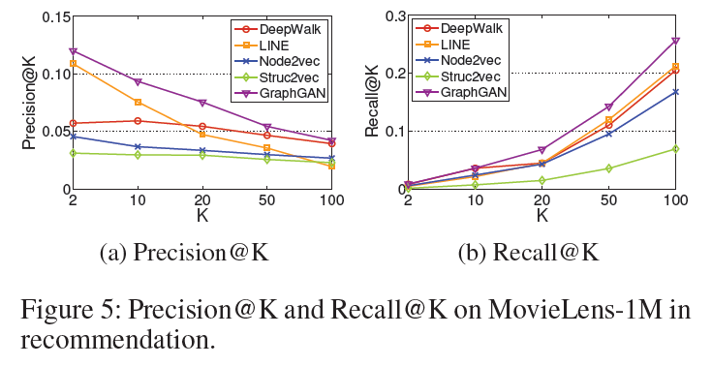
Recommendation

